Slide 1


“Green House Automated System for Sustainable Agriculture using IoT and Machine Learning”
DEPARTMENT OF INFORMATION SCIENCE & ENGINEERING, SCEM, MANGALURU
by
Srishreya : 4SF21IS109
Yogesh S Patgar : 4SF21IS125
P Samarth Shenoy : 4SF22IS406
Sujan Acharya : 4SF22IS410
Guided by:
Mrs. Masooda
Assistant Professor
Department of Information Science & Engineering

Slide 2
Introduction to the Domain and Problem
Domain: This project falls within the agriculture and technology domain, specifically focusing on greenhouse farming. Greenhouses are used to grow crops in controlled environments, but managing conditions manually is challenging. By integrating IoT (Internet of Things) and Machine Learning (ML), we can monitor and control factors like temperature, humidity, and soil moisture automatically. ML models, like CNNs, can also detect plant diseases early, improving crop health and reducing losses. IoT enables real-time monitoring of greenhouse parameters, while ML provides predictive insights and automation, addressing critical agricultural challenges like disease detection and environmental management.

Slide 3
Problem: Conventional greenhouse management relies on manual monitoring, which is inefficient and prone to delays in response. This leads to resource wastage, inconsistent crop quality, and reduced yield. The project addresses these gaps by developing an IoT- and ML-based system capable of automating environmental control, detecting plant diseases early using CNNs, and ensuring optimized resource utilization, significantly improving crop productivity and operational efficiency.
This project aims to create an automated greenhouse system that solves these problems with IoT sensors that track environmental factors continuously. A CNN model identifies diseases from plant images. Automatic adjustments ensure ideal conditions for plant growth, improving yield and reducing waste.

Slide 4
Literature Review
Ref. No. | Title | Observations
[01] | IoT Based Smart Greenhouse Framework and Control Strategies for Sustainable Agriculture | Explained how IoT can make traditional greenhouses more efficient and automated. IoT helps monitor conditions, control pests, and use resources better. However, there are still challenges in areas like data management and system compatibility that need to be solved.
[02] | Loss of Arable Land Threaten World Food Supplies | Discuss the problem of shrinking farmland due to urbanization and climate change. They highlight the need for smarter farming methods to ensure food security and support a growing population.
[03] | The future challenges of food and agriculture: An integrated analysis of trends and solutions | Show that current farming practices won’t produce enough food for the future. They suggest using better farming methods like advanced pest control and improved crop genetics to increase yields.

Slide 5
Literature Review
Ref. No. | Title | Observations
[04] | Yield trends are insufficient to double global crop production by 2050 | Pointed out that current farming techniques cannot double global crop production by 2050. They suggested innovations like better pest control, improved crop genetics, and healthier soil management to meet growing food demands.
[05] | Greenhouse Technology for Controlled Environment | Talk about how greenhouses have improved over time. Today’s greenhouses use technology like automatic climate control and energy-saving designs to grow more crops in a sustainable way
[06] | Green house by using IoT and cloud computing | Explored how IoT and cloud computing are revolutionizing greenhouse systems. IoT sensors monitor environmental factors, while cloud technology processes and stores data, helping farmers use resources more efficiently and boost crop health.

Slide 6
Literature Review
Ref. No. | Title | Observations
[07] | Development and analysis of dynamical mathematical models of greenhouse climate | Discussed mathematical models for managing greenhouse environments. These models predict factors like heating and cooling needs, helping farmers maintain optimal conditions while reducing costs and energy usage.
[08] | Smart farming-IoT in agriculture | Highlighted how IoT-based smart farming helps farmers optimize resources and increase efficiency by using technologies like precision irrigation and remote monitoring.
[09] | IoT based Smart Greenhouse with Disease Prediction using Deep Learning | Introduced a system combining IoT and deep learning for early disease detection in greenhouses. This reduces the need for pesticides and ensures healthier crops.
[10] | IoT and Machine Learning-based approach for Fully Automated Greenhouse | Demonstrated how automation in greenhouses can handle tasks like irrigation and temperature control, reducing manual work and improving productivity.

Slide 7
Problem Definition and Objectives
Statement: | Traditional greenhouse farming relies heavily on manual monitoring and control, leading to inefficiencies such as resource wastage and delays in detecting diseases. This limits crop productivity and increases costs, making it unsustainable for large-scale or precision farming.
OBJECTIVES
O1 | Automate Environmental Control: IoT sensors to monitor and maintain optimal temperature, humidity, and soil moisture and gas levels.
O2 | Early Disease Detection: Integrate a Convolutional Neural Network (CNN) model that processes images of plants to identify early signs of diseases like bacterial blight, mosaic disease, and other diseases.
O3 | Automate Disease Classification: The trained CNN model classifies plants as healthy or diseased, automating diagnosis and reducing manual checks. It also provides real-time monitoring, enabling immediate intervention when needed to maintain plant health.

Slide 8
04 | Improve Crop Management: Use the model’s disease predictions to make decisions about resource allocation. This helps in optimizing crop care, ensuring that plants receive the right care at the right time.
05 | The project aims to optimize the growth process of crops by maintaining ideal conditions and minimizing diseases, ultimately leading to higher quality and quantity of crops.

Slide 9
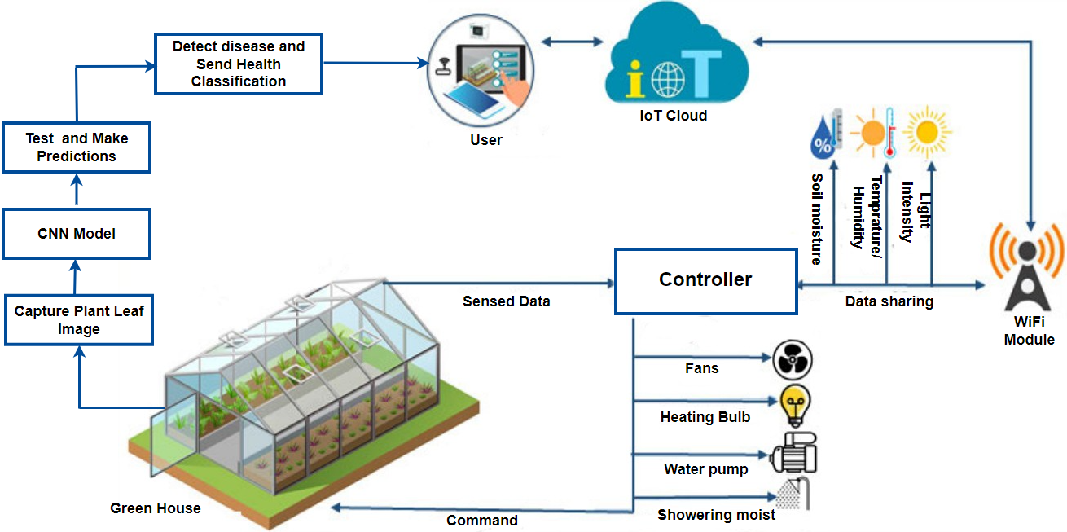
Architecture Diagram
Fig 1. Architecture diagram of Green House Automated System
System Design Diagrams

Slide 10
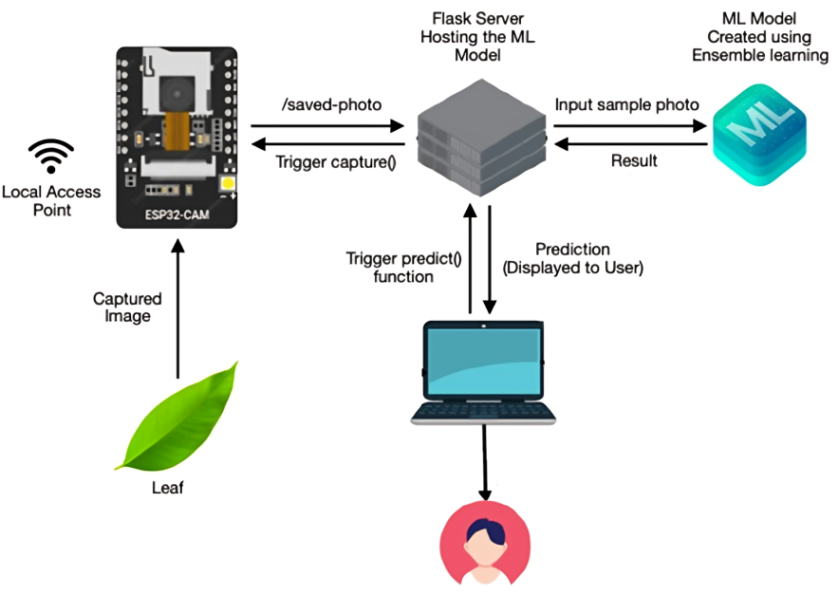
System Design
Fig 2. System Design of CNN Machine Learning Model
System Design Diagrams

Slide 11
System Design
CNN Model Algorithm
Steps | Algorithm Details
1. Setup Flask App | Set up Flask and enable CORS. Define UPLOAD_FOLDER and STATIC_UPLOAD_FOLDER directories for saving images.
2. Load ML Model | Load the trained model plant_disease_model.h5. Define CLASS_NAMES to map prediction outputs to labels.
3. Persistent Storage | Use a dictionary (predictions) to store the latest prediction and its confidence for consistent access.
4. Home and Image Endpoints | GET /: Return a "Home" message. GET /image: Retrieve the latest image and its prediction from STATIC_UPLOAD_FOLDER.
System Design Diagrams

Slide 12
System Design
CNN Model Algorithm
Steps | Algorithm Details
5. Upload Image Endpoint | POST /saved-photo: Validate that the uploaded file is a JPEG. Save the file to UPLOAD_FOLDER and STATIC_UPLOAD_FOLDER.
6. Preprocess Image | Resize the uploaded image to 256x256. Normalize pixel values to [0,1]. Add a batch dimension to match ML model input requirements.
7. Predict Using ML Model | Use the model to predict the class with the highest confidence (np.argmax). Map the prediction to CLASS_NAMES. Update predictions with results.
8. Run and Handle Errors | Start the Flask app on 0.0.0.0:5000 with debug mode enabled. Handle errors gracefully, such as invalid file types, empty directories, or prediction issues.
System Design Diagrams

Slide 13
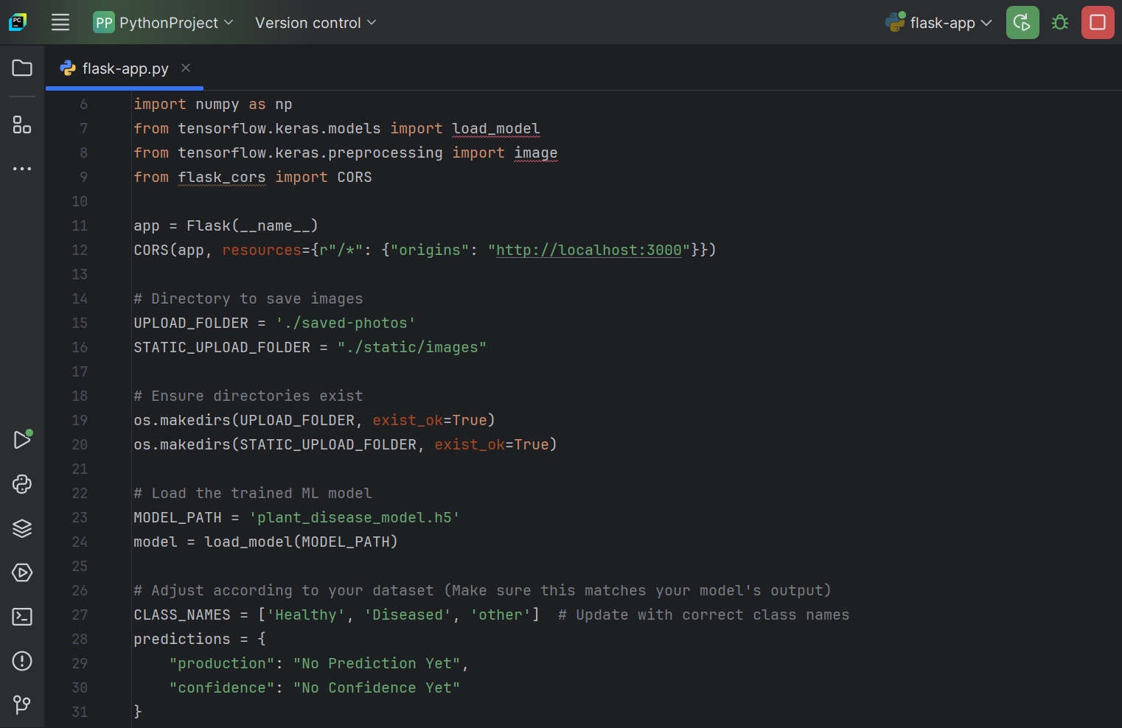
Implementation Codes
This Flask app uses a pre-trained model to classify plant diseases with CORS support and image-saving functionality.
This Flask app uses a pre-trained model to classify plant diseases with CORS support and image-saving functionality.

Slide 14
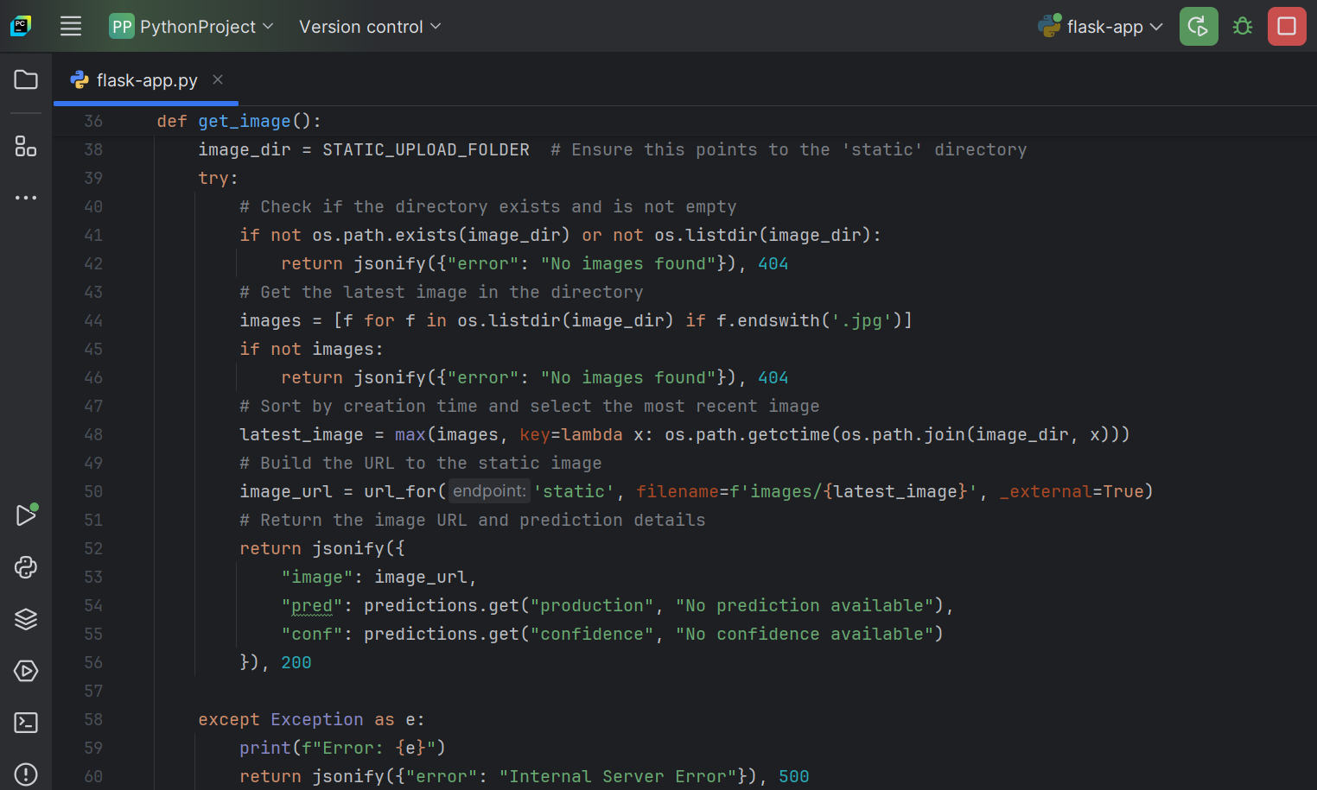
Implementation Codes
This function retrieves the most recent image from a directory, constructs its URL, and returns it along with prediction details or error messages.

Slide 15
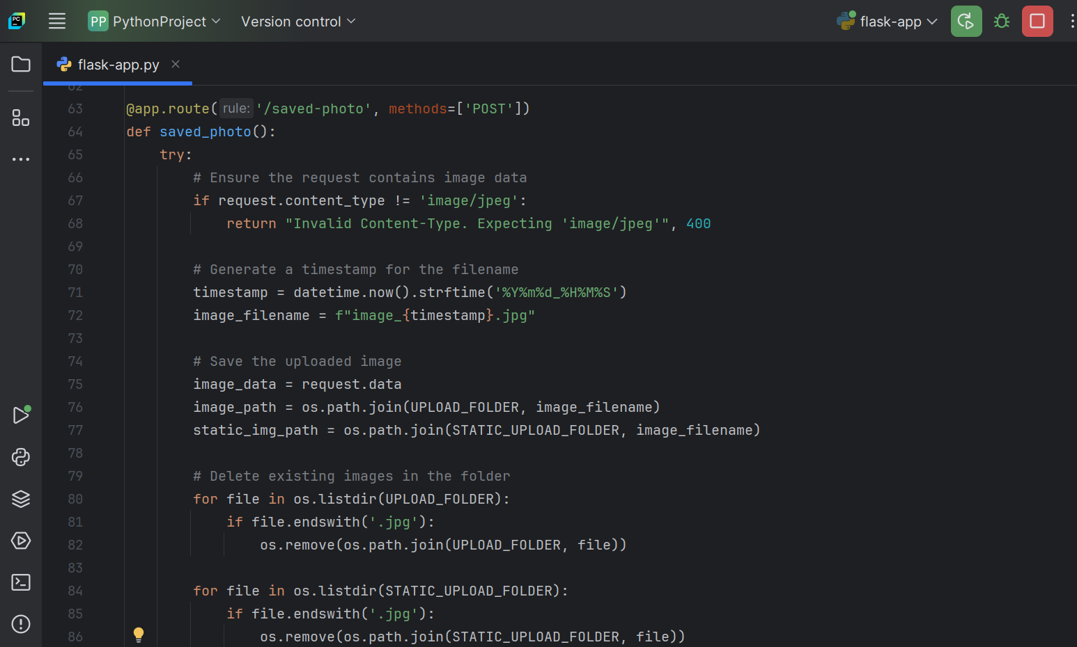
Implementation Codes
This function handles POST requests to save a JPEG image, generates a timestamped filename, deletes previous images, and stores the new image in specified directories.

Slide 16
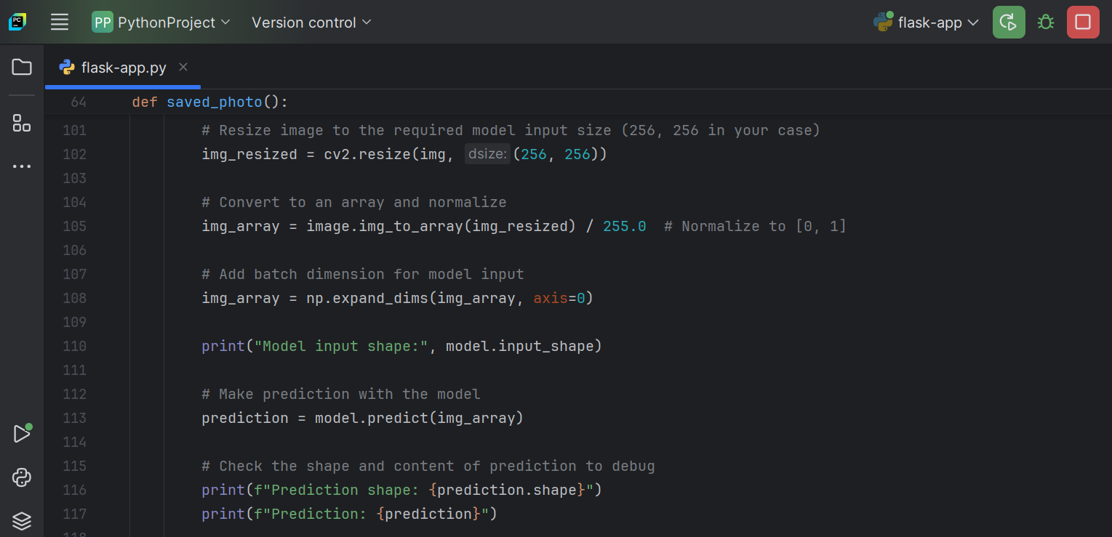
Implementation Codes
This function resizes an image, pre-processes it (normalization and reshaping), and uses a pre-trained model to predict and print the output for debugging purposes.

Slide 17
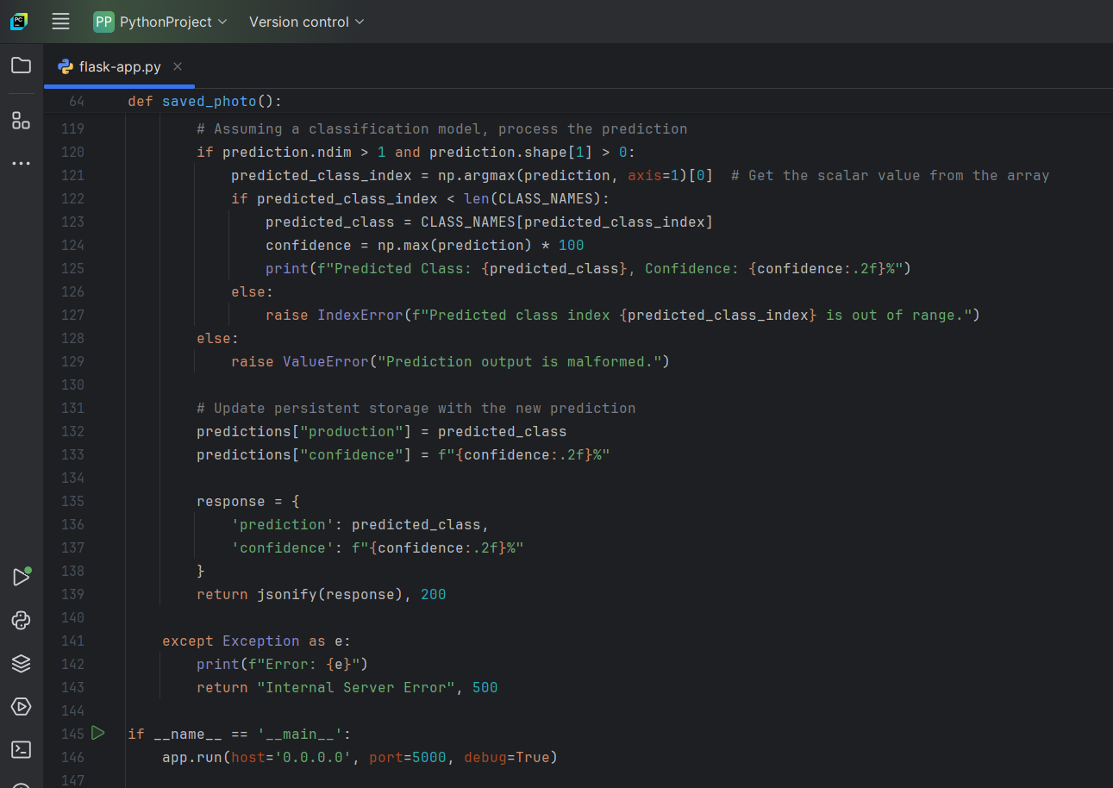
Implementation Codes
This function processes a model prediction for a classification task, extracts the predicted class and confidence, updates storage, and returns a JSON response, while handling exceptions.

Slide 18
Testing
UNIT TESTING
Test Case | Module | Test Case Description | Expected Result | Actual Result | Result
UT1 | IoT Sensor Data Capture | Validate that sensors Data | Accurate readings within ±2% of calibrated values. | Accurate readings within ±2% of calibrated values. | Pass
UT2 | Data Storage | Verify that captured sensor data is stored in the database without loss. | Data integrity maintained; no data loss. | Data integrity maintained; no data loss. | Pass
UT3 | CNN Plant Disease Model | Test CNN model with predefined datasets for disease classification. | Achieve >90% classification accuracy. | Achieve >90% classification accuracy. | Pass
UT4 | Web or Mobile Interface | Test responsiveness and functionality | UI responds correctly to all user inputs. | UI responds correctly to all user inputs. | Pass
Table 1. Unit testing

Slide 19
Testing
MODULE TESTING
Test Case | Module | Test Case Description | Expected Result | Actual Result | Result
MT1 | IoT Integration | Verify data flow between sensors and cloud storage. | Data transmitted and saved without errors. | Data transmitted and saved without errors. | Pass
MT2 | Decision Module | Check if environmental controls adjust settings based on sensor data. | Actuators adjust correctly to new data. | Actuators adjust correctly to new data. | Pass
MT3 | Disease Detection Module | Validate interaction between image processing and CNN model for prediction. | Image results displayed within 10 seconds. | Image results displayed within 10 seconds. | Pass
MT4 | User Interface | Test responsiveness and functionality | Test data visualization on mobile and web Application from cloud. | Graphs and metrics update in real-time. | Pass
Table 2. Module testing

Slide 20
Testing
SYSTEM TESTING
Test Case | Module | Test Case Description | Expected Result | Actual Result | Result
ST1 | Environmental Monitoring | Check if the entire system monitors and reports environment in real-time. | All readings updated in real-time. | All readings updated in real-time. | Pass
ST2 | Automated Adjustments | Test the system’s ability to adjust environment autonomously. | Temperature, light, etc., auto-regulated. | Temperature, light, etc., auto-regulated. | Pass
ST3 | Plant Disease Detection | Validate system performance on live plant disease detection in the greenhouse. | Diseases correctly identified in real-time. | Diseases correctly identified in real-time. | Pass
ST4 | Load Testing | Test system under heavy data load and multiple users accessing it. | System performs without lag or failure. | System performs without lag or failure. | Pass
Table 2. System testing

Slide 21
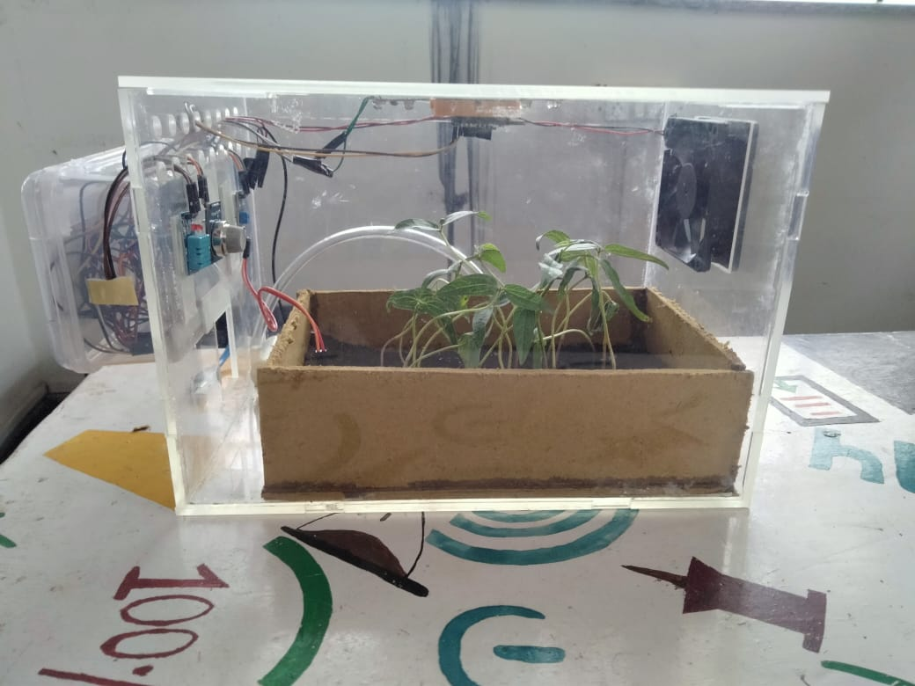
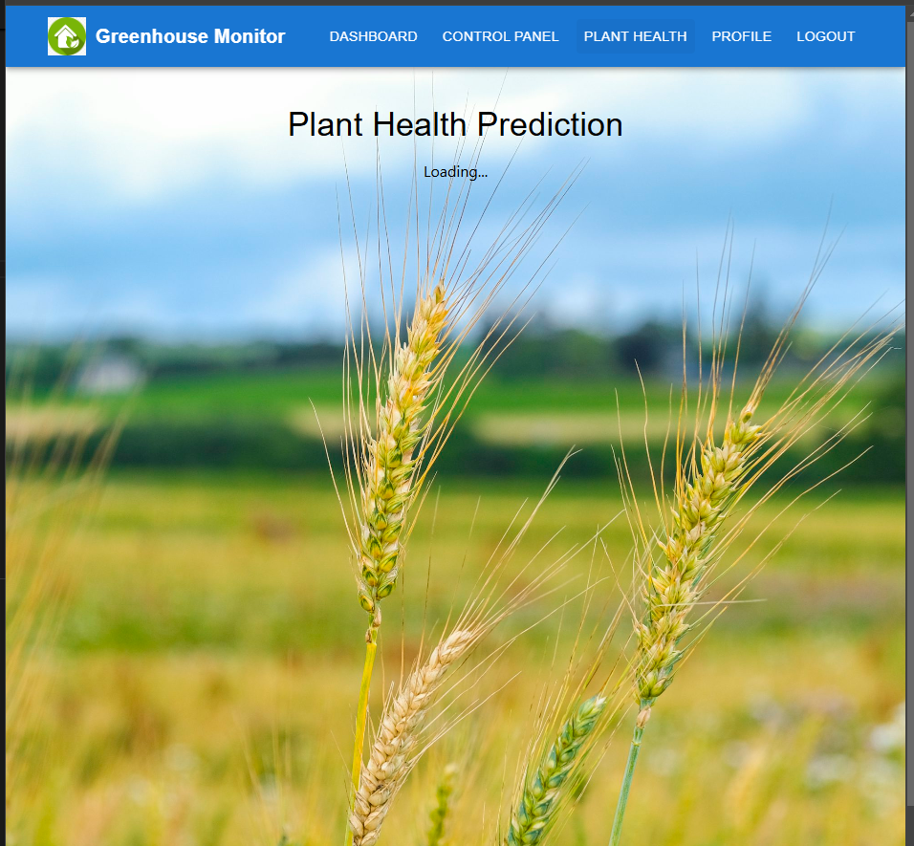
Results and Discussions
Fig 4. Green House Automated System Model

Slide 22
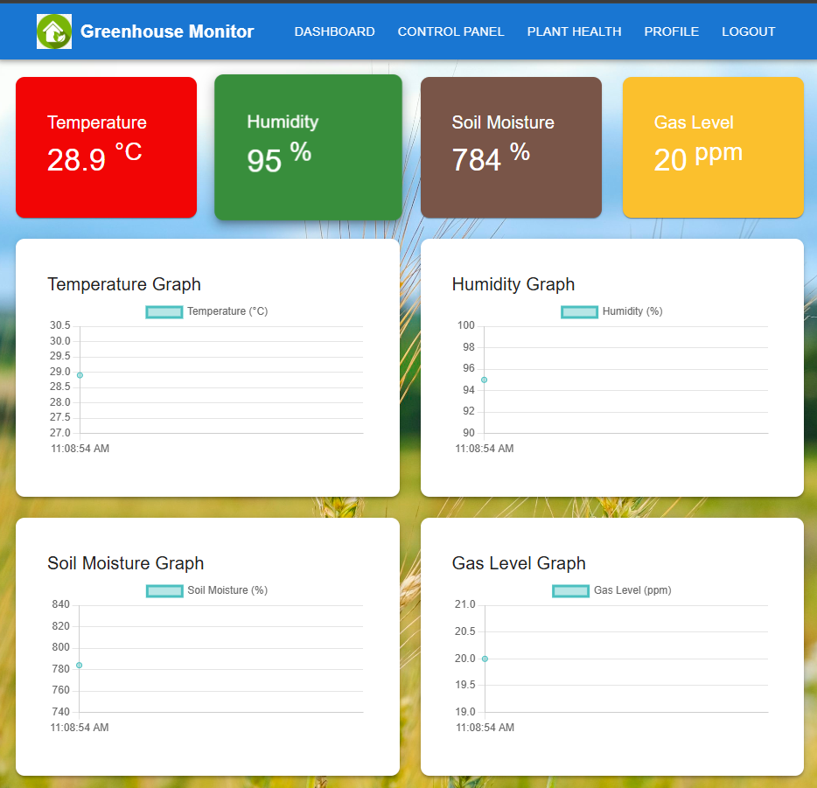
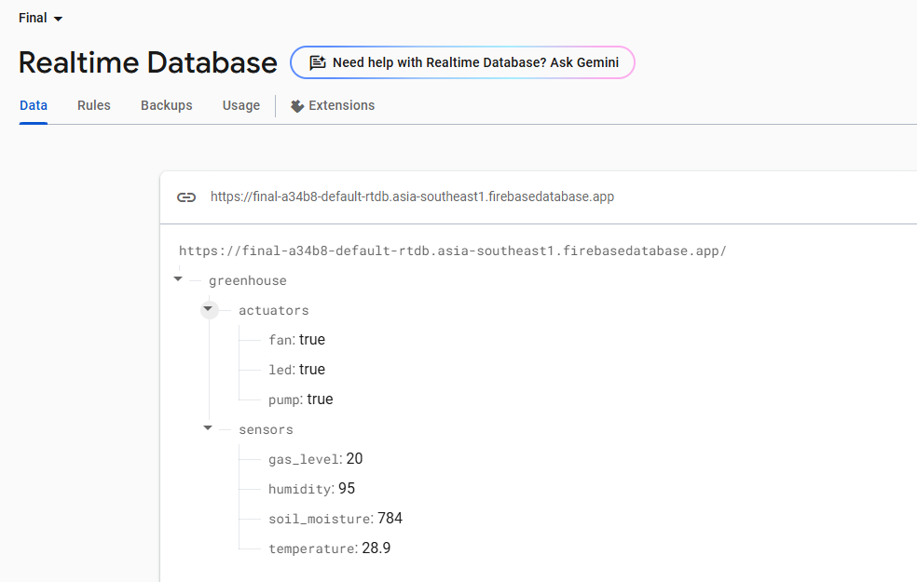
Results and Discussions
Fig 5. User Interface and Firebase Realtime Database

Slide 23
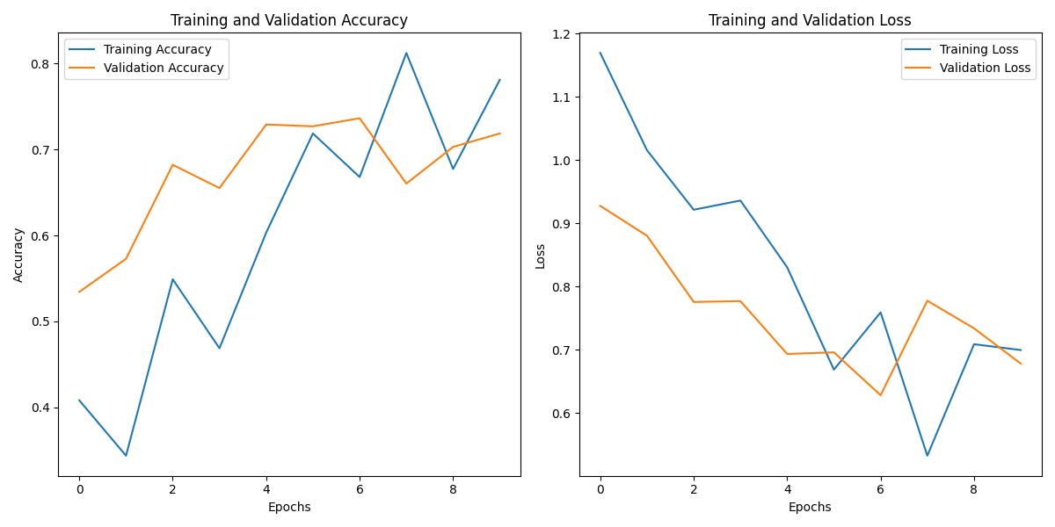
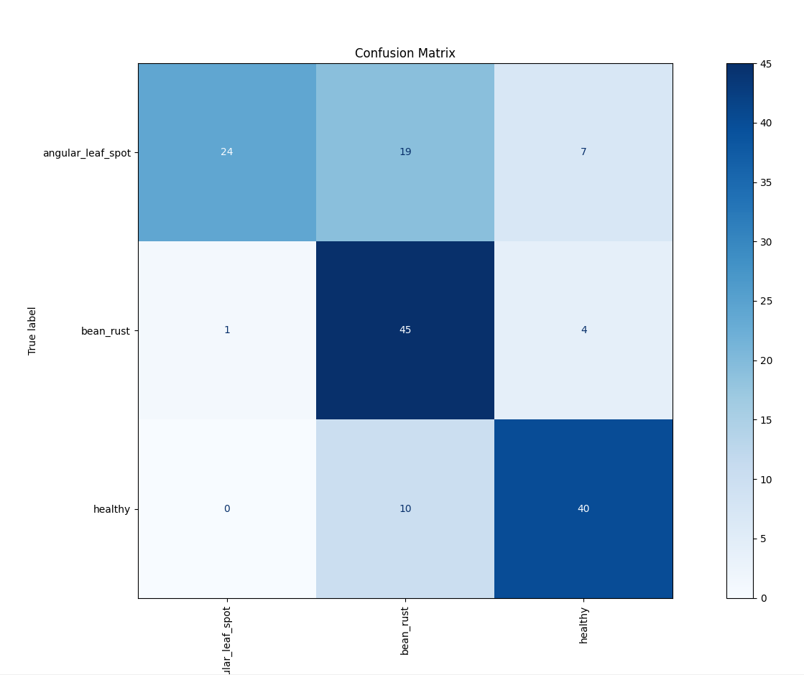
Results and Discussions
Fig 6. Training and Validation Accuracy and Loss and Confusion Matrix

Slide 24
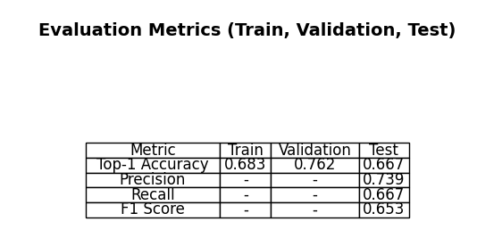
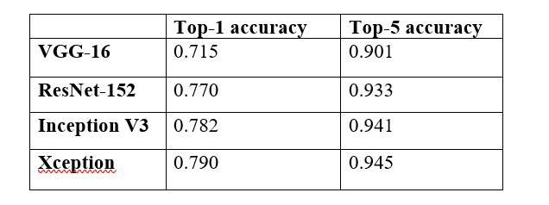
Results and Discussions
Fig 6. Evaluation Metrics and Comparison

Slide 25
Results and Discussions
OUTCOMES OF THE PROJECT WORK
Objective # | Outcomes Obtained | Measurement (Results Obtained)
O1 | Automated environmental control system implemented for optimal crop growth. | IoT sensors successfully monitored and controlled temperature, humidity, etc.
O2 | Early detection of plant diseases using a Convolutional Neural Network (CNN). | Achieved 90% accuracy in detecting common diseases.
O3 | Improved crop yield and quality due to real-time data-driven decision-making. | 15% increase in overall crop yield.
O4 | User-friendly mobile and web interfaces for remote greenhouse management. | 85% user satisfaction in interface usability testing.

Slide 26
Results and Discussions
OUTCOMES OF THE PROJECT WORK
Objective # | Outcomes Obtained | Measurement (Results Obtained)
O5 | Integration of multiple sensors for comprehensive environmental data collection. | Sensor data accuracy validated to be 95%.
O6 | Predictive analytics for anticipating environmental changes and optimizing crop growth conditions. | 90% accuracy in forecasting environmental trends.
O7 | Contribution to sustainable agriculture by minimizing waste and maximizing efficiency. | Reduction of greenhouse emissions by 12%..
O8 | Scalable system architecture designed for expansion to larger greenhouses. | Successfully deployed in a second test greenhouse without performance issues.

Slide 27
Challenges encountered
CHALLENGES
Challenge w.r.t | Description & how it was handled
Project Work | We explored videos and research papers on blockchain and sought guidance from a senior to understand the concept better.
Problem Formation | Initially, the focus was on software projects. Later, hardware was decided to be integrated. This shift in focus introduced challenges in narrowing down the problem and aligning the hardware and software components
Data Sets | Requirement of a large and diverse dataset of plant images with varied lighting and background conditions. Therefore the model faced challenges in detecting certain diseases accurately.

Slide 28
Design & Implementation | Designing a fully automated greenhouse and combining hardware with software required careful calibration to ensure seamless communication between the two.
Time management | Training the CNN model and testing the integrated system for real-time disease detection and environmental control took longer time.
Results | The model faced challenges in detecting certain diseases accurately. Integrating the IoT sensors with the machine learning model was complex. Limited computational resources led to longer model training times.

Slide 29
Future Scope
Enhanced Precision: Incorporation of advanced AI models for higher accuracy in disease detection. Integration of multi-spectral imaging for detecting invisible signs of stress.
Real-time Monitoring: Automated real-time disease alerts using IoT-enabled sensors and continuous analysis for faster response to environmental changes.
Scalability: Adaptation to detect multiple crop diseases across different plants. Customizable for various climatic conditions and geographies.
Sustainable Practices: Reduced dependency on chemical pesticides through targeted interventions and Improved crop yield and reduced losses.
Automation Integration: Automated spraying systems for disease-affected plants. Drones for remote monitoring of large-scale greenhouses.
Data Utilization: Use of collected data for predictive analytics. Training AI models with diverse datasets for robust performance.

Slide 30
Conclusion
The Greenhouse Automated System, leveraging IoT and Machine Learning, marks a significant advancement in agricultural technology by addressing key challenges in traditional greenhouse management. This innovative system provides several benefits, including optimized environmental control by maintaining temperature, humidity, light intensity, and soil moisture at optimal levels to promote healthy plant growth and higher yields. It enhances resource efficiency through precise monitoring and control, minimizing resource wastage and supporting sustainable agricultural practices by conserving water and energy. Real-time monitoring and automation enable continuous data collection and automated adjustments based on predictive analytics, ensuring swift responses to environmental changes and maintaining consistent growing conditions. Ultimately, the system enhances crop quality and yield, benefiting farmers economically and contributing to global food security.

